Slide 1

Credit Card Digital Detective 1.0.1 © Mohamed Abdi & Timothy Ayoade Co.
No Foul, No Harm
Security only guaranteed with good data
Notes:
Front Page

Slide 2
Objective
Problem Definition: Create a proactive model that is able detect and block fraudulent transactions so our clients are not charged for purchase they are not responsible for.
Process Steps: Using Several Machine Learning Algorithms to classify if a Credit card transactions is fraudulent or not.
Pandas was used for data cleansing and exploration.
Tableau was used for visualization
SciKitLearn was used for the Machine learning library, we used the Logistic regression, Random Forest, and Support Vector Machine algorithms

Slide 3
Source Data
Meta-data :
Time - Number of seconds elapsed between this transaction and the first transaction in the dataset
V1 - V28 - PCA Dimensionality reduction to protect user identities and sensitive features(V1-V28)
Amount - Amount Charged on Card
Class – “0” Valid Transaction, “1” Fraudulent
PCA – Principal Component Analysis - performs a linear mapping of the data to a lower-dimensional space in such a way that the variance of the data in the low-dimensional representation is maximized
Data Overview
Class :- 492 frauds out of 284,807 transactions. The dataset is highly unbalanced, the positive class (frauds) account for 0.172% of all transactions.
Data Adjustment :-
The original dataset was too large to import into Jupyter so we extracted 50,492 rows to run data In Scikit Learn
Adjusted the data with 1000 rows to see what a 50/50 fraud to normal transactions dataset would predict

Slide 4
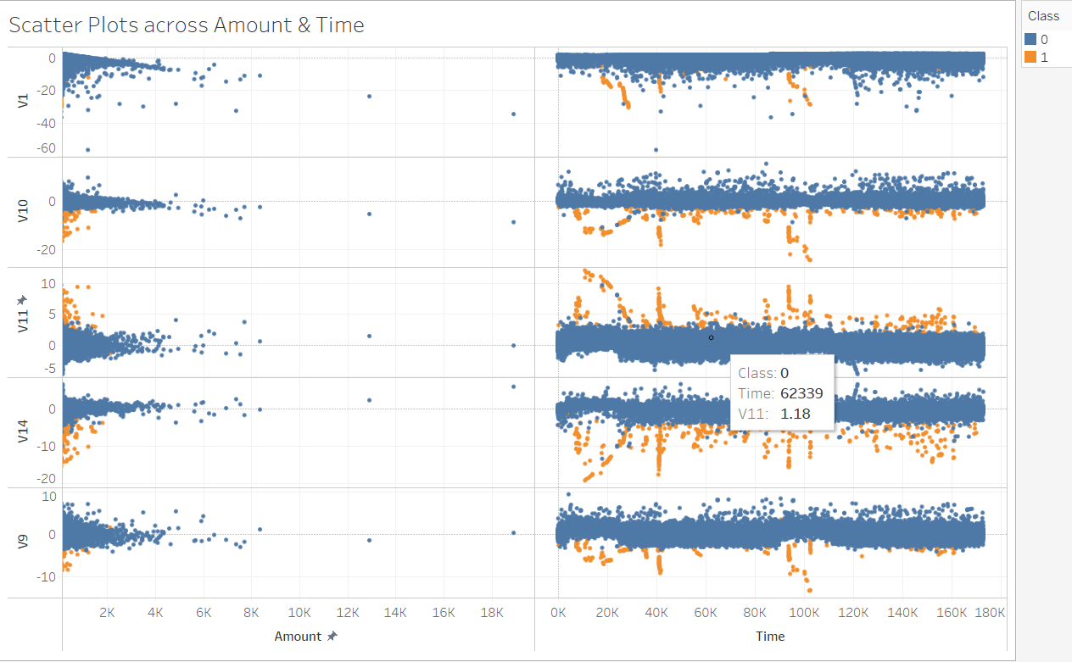
Data Visualization #1

Slide 5
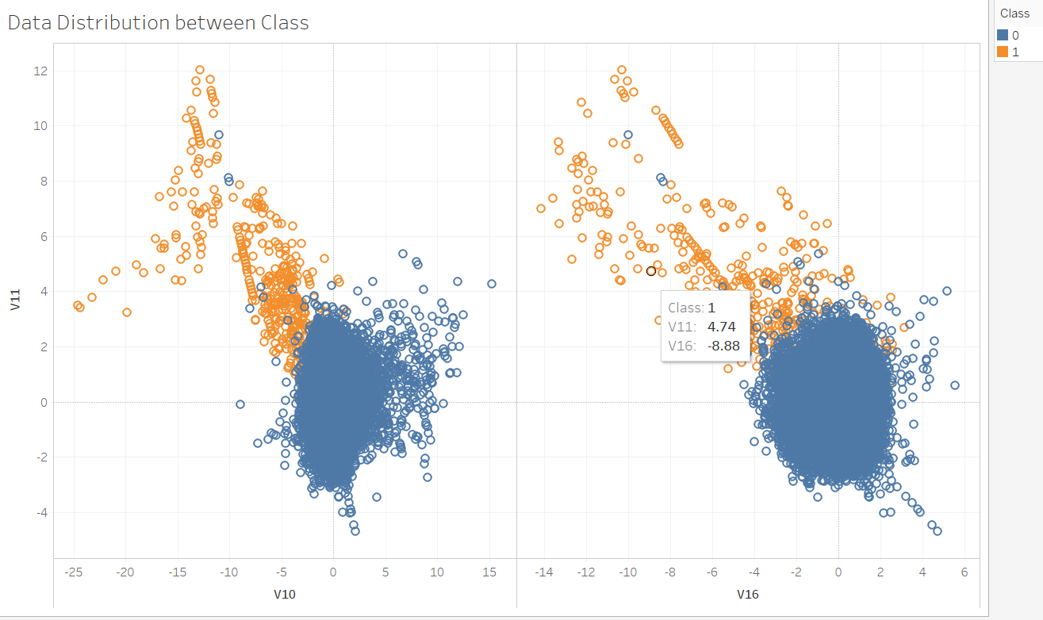
Data Visualization #2

Slide 6
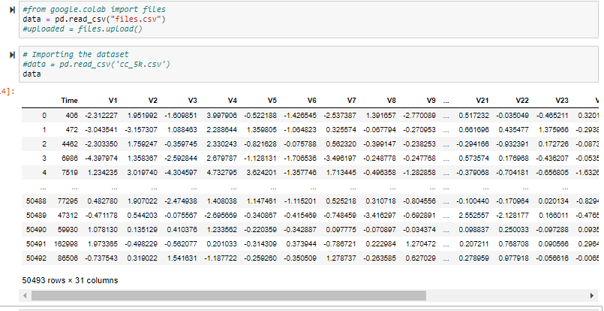
Data Analysis
Data Cleansing:
Reduced total data to 50,492
Remove columns with incomplete data
Data Adjustments:
Original Data:- 492 frauds out of 284,807 transactions. The dataset is highly unbalanced, the positive class (frauds) account for 0.172% of all transactions.
First Adjustment: 492 frauds out of 50,492, still unbalanced at 0.97% of the total data
Final Adjustment: 492 frauds out of 1000, much more balanced at 49.2% of the data

Slide 7

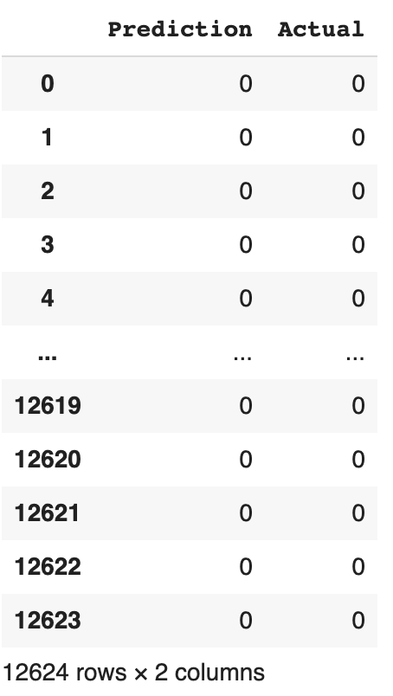
ML Logistic Regression
Split data into Train and Test set, scale the data and Predict if transaction is fraud or not
DataFrame comparing actual vs predicted
Results:
Our model was able to predict whether a transaction was fraudulent or not 99.7% of the time

Slide 8
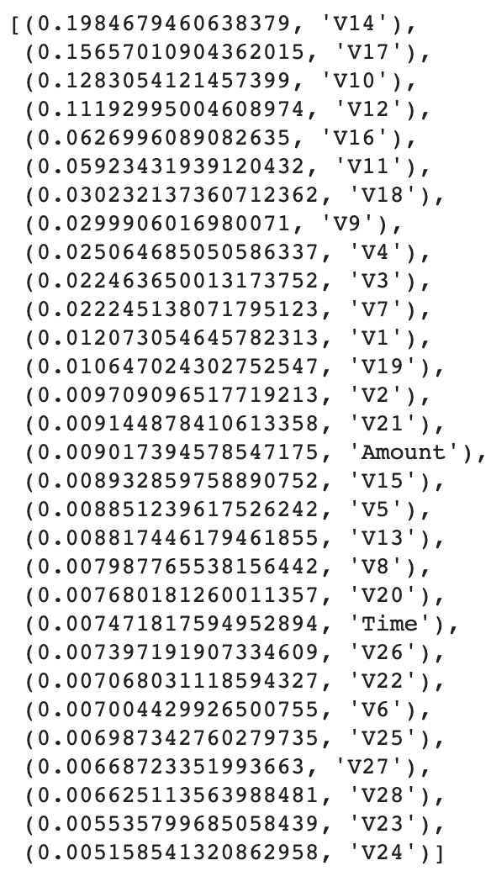
ML Random Forest
Results from Random Forest Analysis:
List of features in the data sorted by their importance
The Random Forest Algorithm returned a slightly higher score

Slide 9

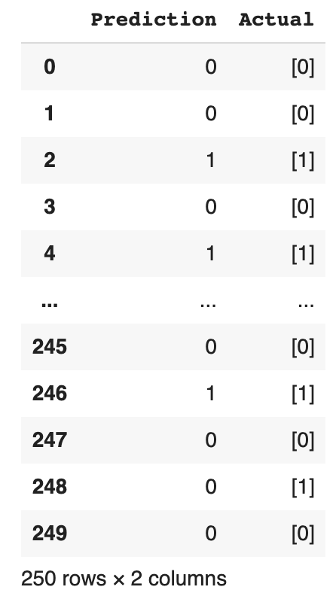
ML Logistic Regression Adj.Data
Split data into Train and Test set, scale the data and Predict if transaction is fraud or not
When comparing the actual vs the predicted the machine made more errors with the smaller dataset
When we made the dataset smaller our accuracy decreased

Slide 10
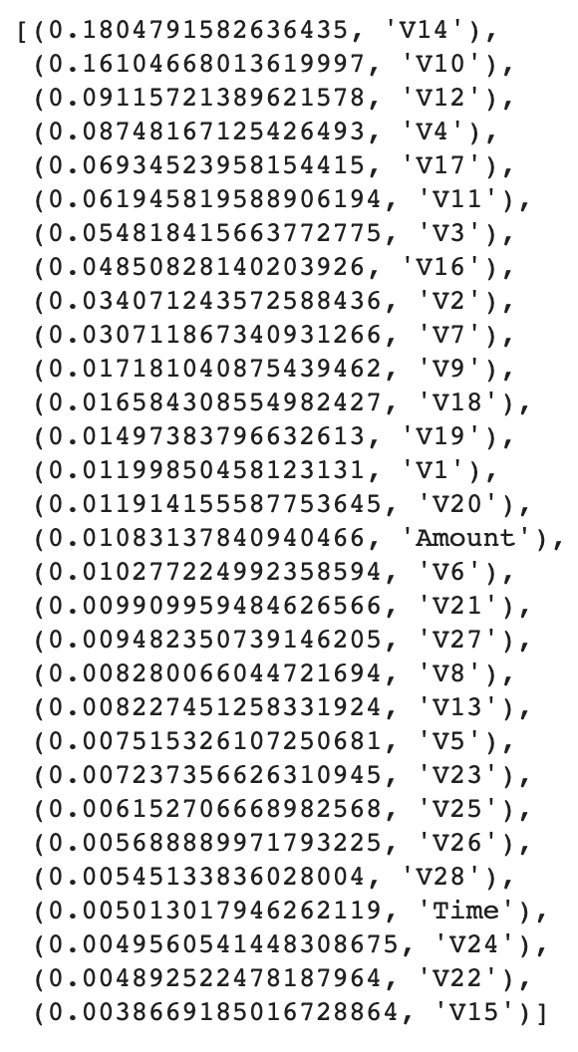
ML Random Forest Adj.Data
Results from Random Forest with adjusted data
List of features sorted by their importance

Slide 11


ML - Results Compared
Logistic Regression
Random Forest
Support Vector Machine

Slide 12
ML - Conclusion
We concluded that for our particular dataset that the Random Forest Algorithm was the most accurate and useful. It not only returned a higher score but also shows us which features had the most impact on the prediction.

